Slide 1
Final Assignment Presentation
THE BATTLES OF NEIGHBORHOODS
By Ardalan Ahmadvand
Notes:
© Copyright PresentationGo.com – The free PowerPoint library

Slide 2
INTRODUCTION
•Toronto city overview for ABC Grocery
•ABC Grocery Strategic Plan and Overview
•ABC Grocery Business Problem
•Choice of the first neighborhood to offer services.
•The neighborhood should enable easy replication.
•The neighborhood should have high demand.
•The neighborhood should have lower competition.
Notes:
© Copyright PresentationGo.com – The free PowerPoint library

Slide 3
INTRODUCTION
• Success Criteria:
• Good recommendation of neighborhood that meets above points.
• It should have capability to enable latest information whenever required.
Notes:
© Copyright PresentationGo.com – The free PowerPoint library

Slide 4
DATA DESCRIPTION
• Data Requirements for this project:
• Neighborhood Information (i.e. name, coordinates, populations).
• Venue information (i.e. name, category, coordinates)
• Data Sources for this project:
• Wikipedia Pages
• Foursquare.com
• Data Processing for this project:
• Data cleaning is required
• Data needs to be in a structured format
Notes:
© Copyright PresentationGo.com – The free PowerPoint library

Slide 5
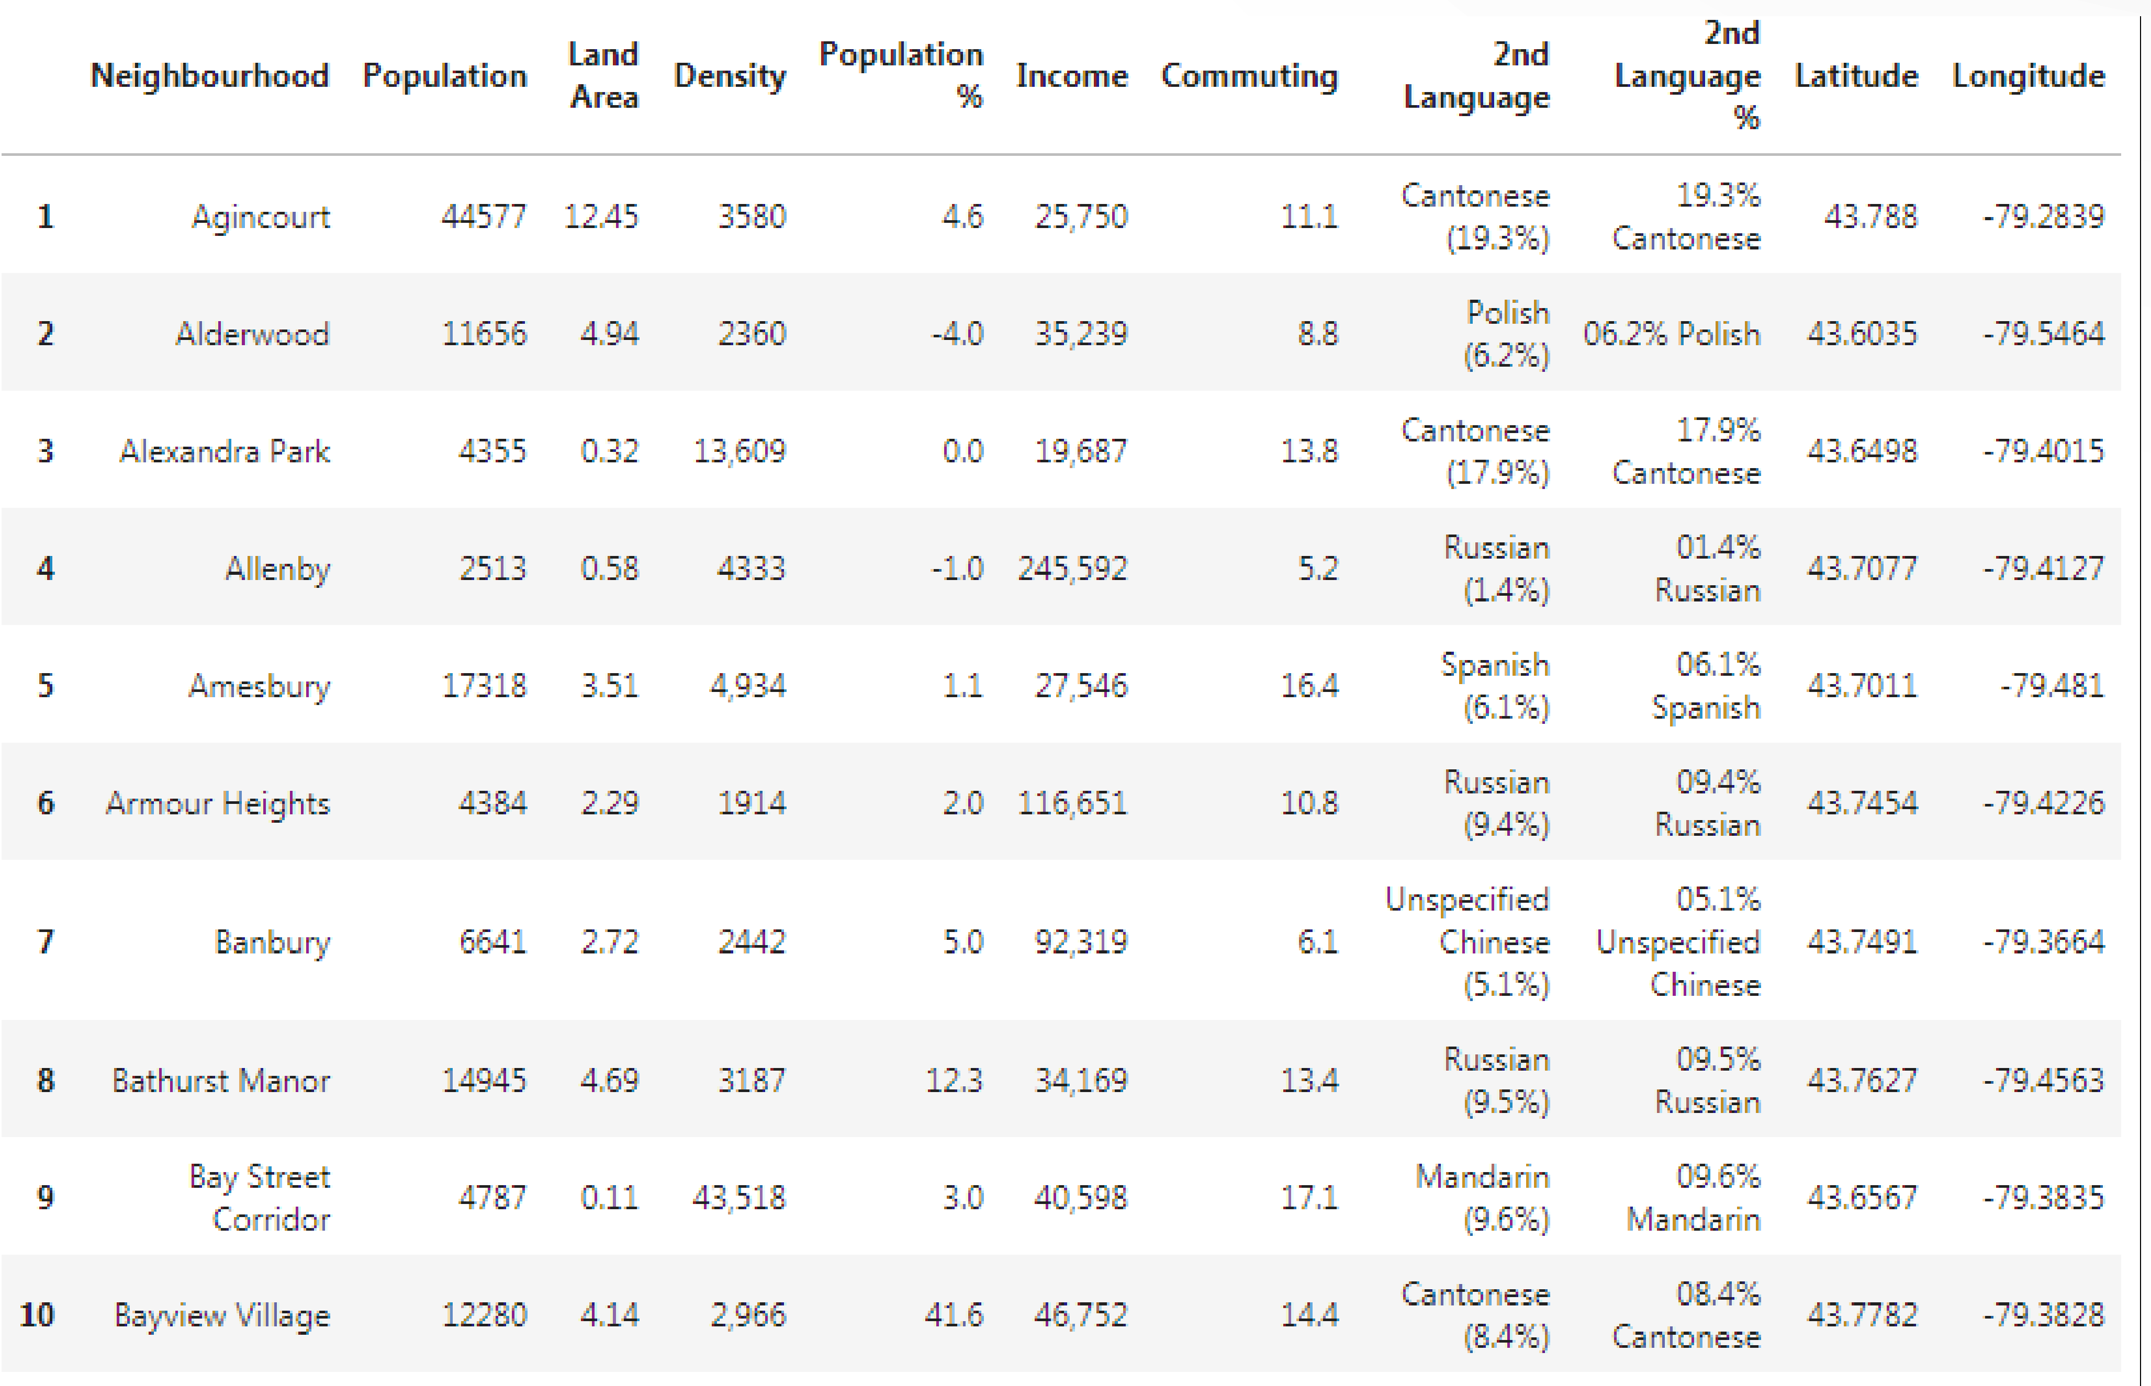
Notes:
© Copyright PresentationGo.com – The free PowerPoint library

Slide 6
METHODOLOGY
• Data Scrapping Technique
• To scrap the neighborhood data from Wikipedia
• To make the data into a structured format
• Foursquare.com
• Retrieving venue information from above API.
• K-Means Machine Learning
• Segment and cluster similar neighborhoods
• Group them based on most common venues
• Scoring Weightage
• Population count has 50% weightage
• Venue (fewer grocery) has another 50% weightage
Notes:
© Copyright PresentationGo.com – The free PowerPoint library

Slide 7
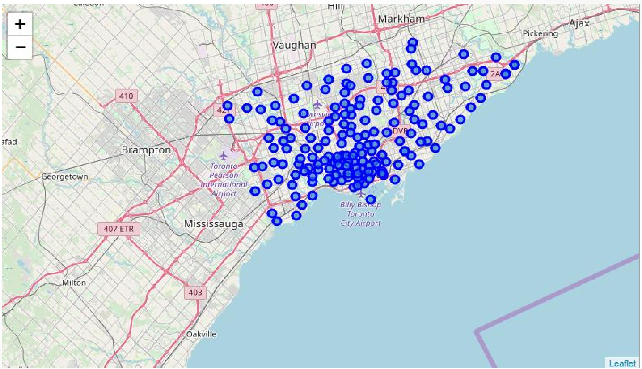
INTRODUCTION
Notes:
© Copyright PresentationGo.com – The free PowerPoint library

Slide 8
RESULT
• Clustering Similar Neighborhoods
• Grouping based on common venues
• Neighborhood with high population
• Ranking the neighborhoods based on population count
• Topmost common venue
• Ranking the neighborhoods based on common venue w/o Grocery
Notes:
© Copyright PresentationGo.com – The free PowerPoint library

Slide 9
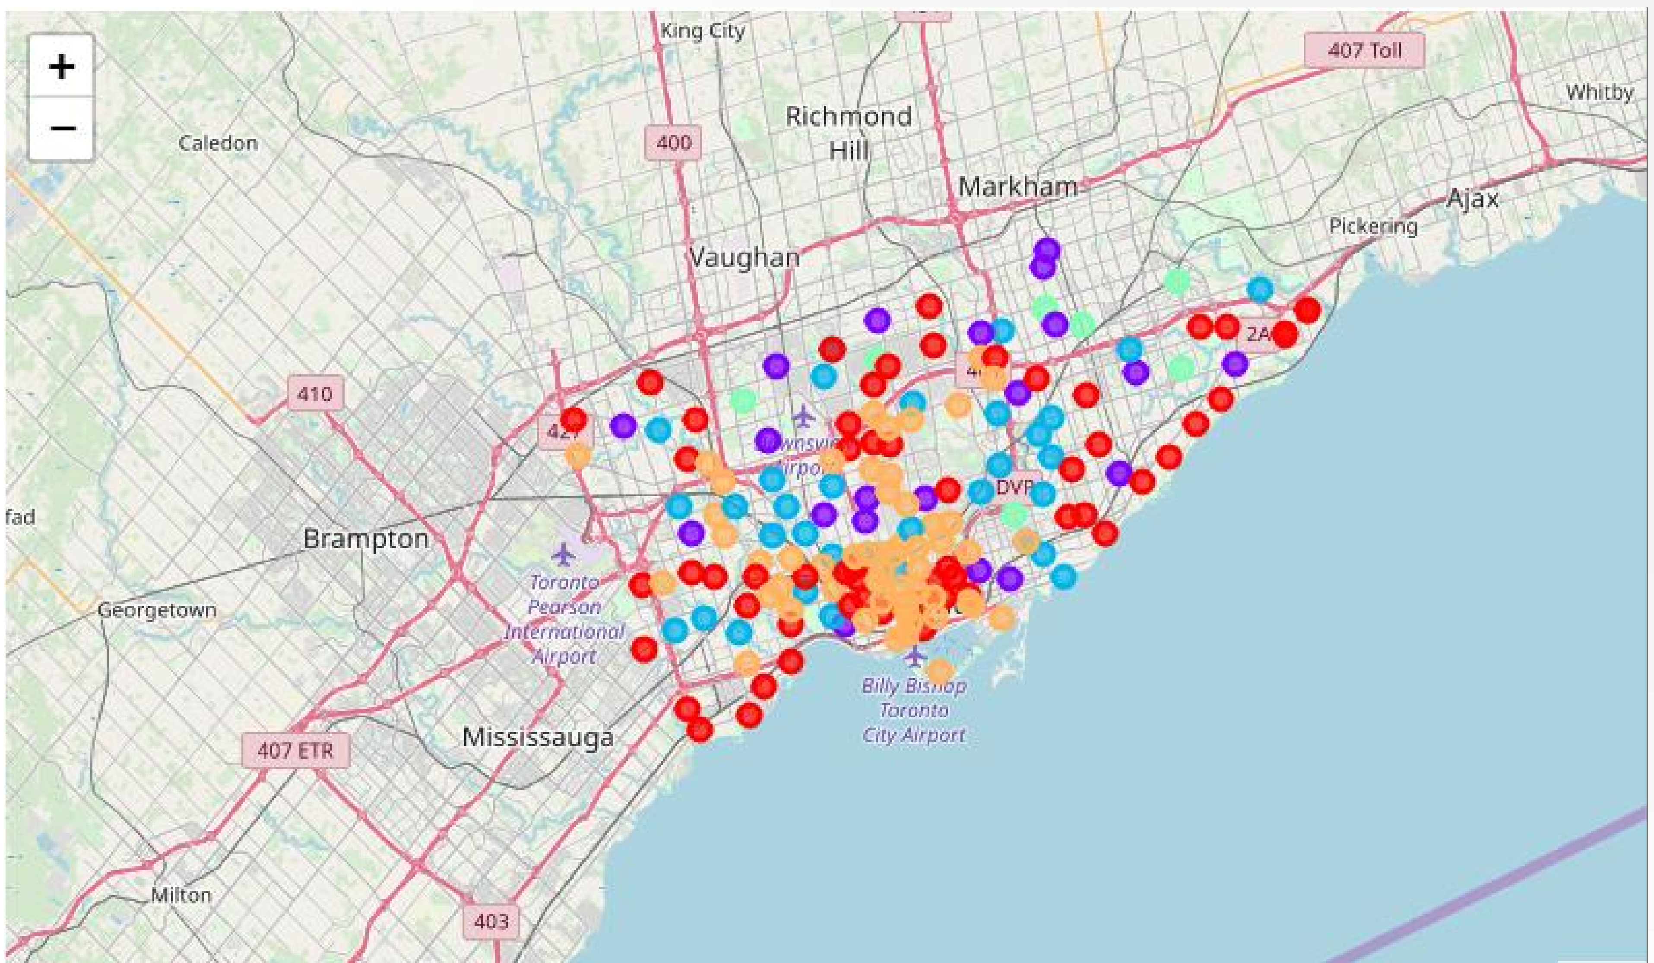
Notes:
© Copyright PresentationGo.com – The free PowerPoint library

Slide 10
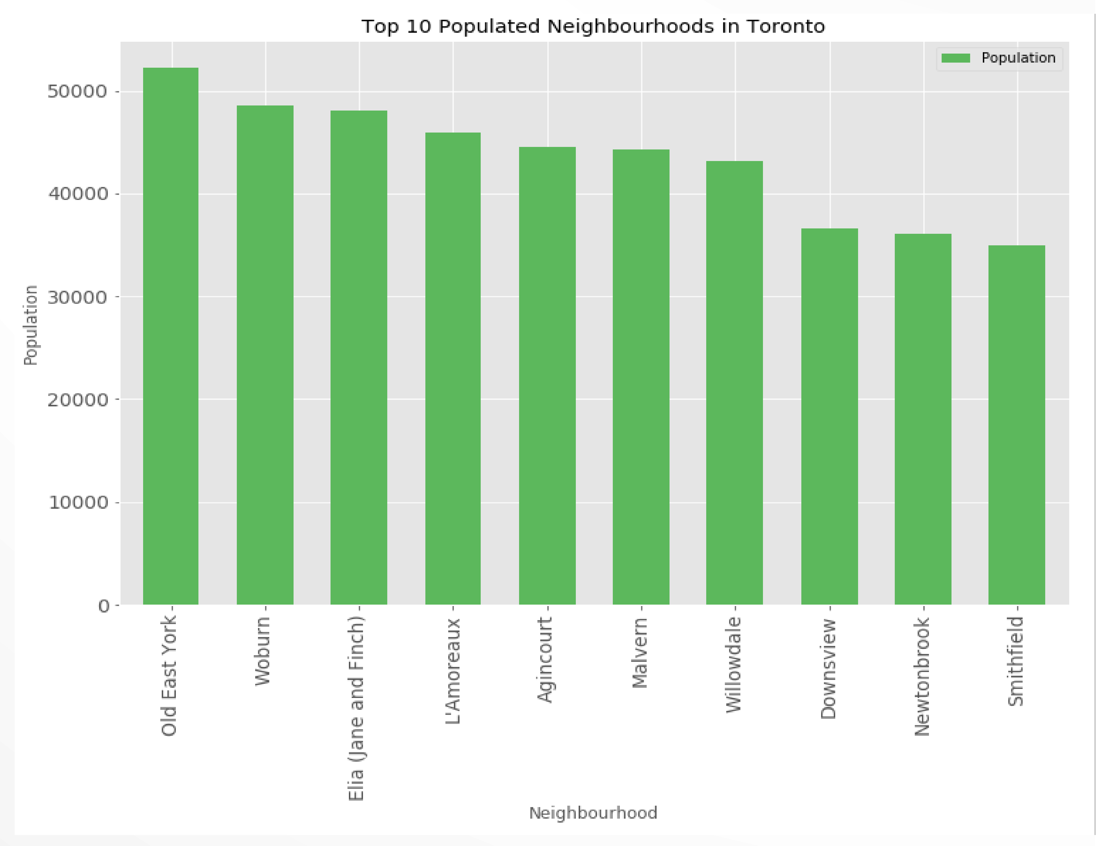
Notes:
© Copyright PresentationGo.com – The free PowerPoint library

Slide 11
DISCUSSION
• Result Review:
•First cluster looks to offer the best business expansion opportunity.
•Humbermede neighborhood in the first cluster looks to meet the key business criteria whereby it will offer the highest demand (i.e. high population) and lowest competition (i.e. lower supply).
• Additional Observation:
•High number of Punjabi people.
•Worthwhile to consider Punjabi food or related supplies offering in this neighborhood.
Notes:
© Copyright PresentationGo.com – The free PowerPoint library

Slide 12
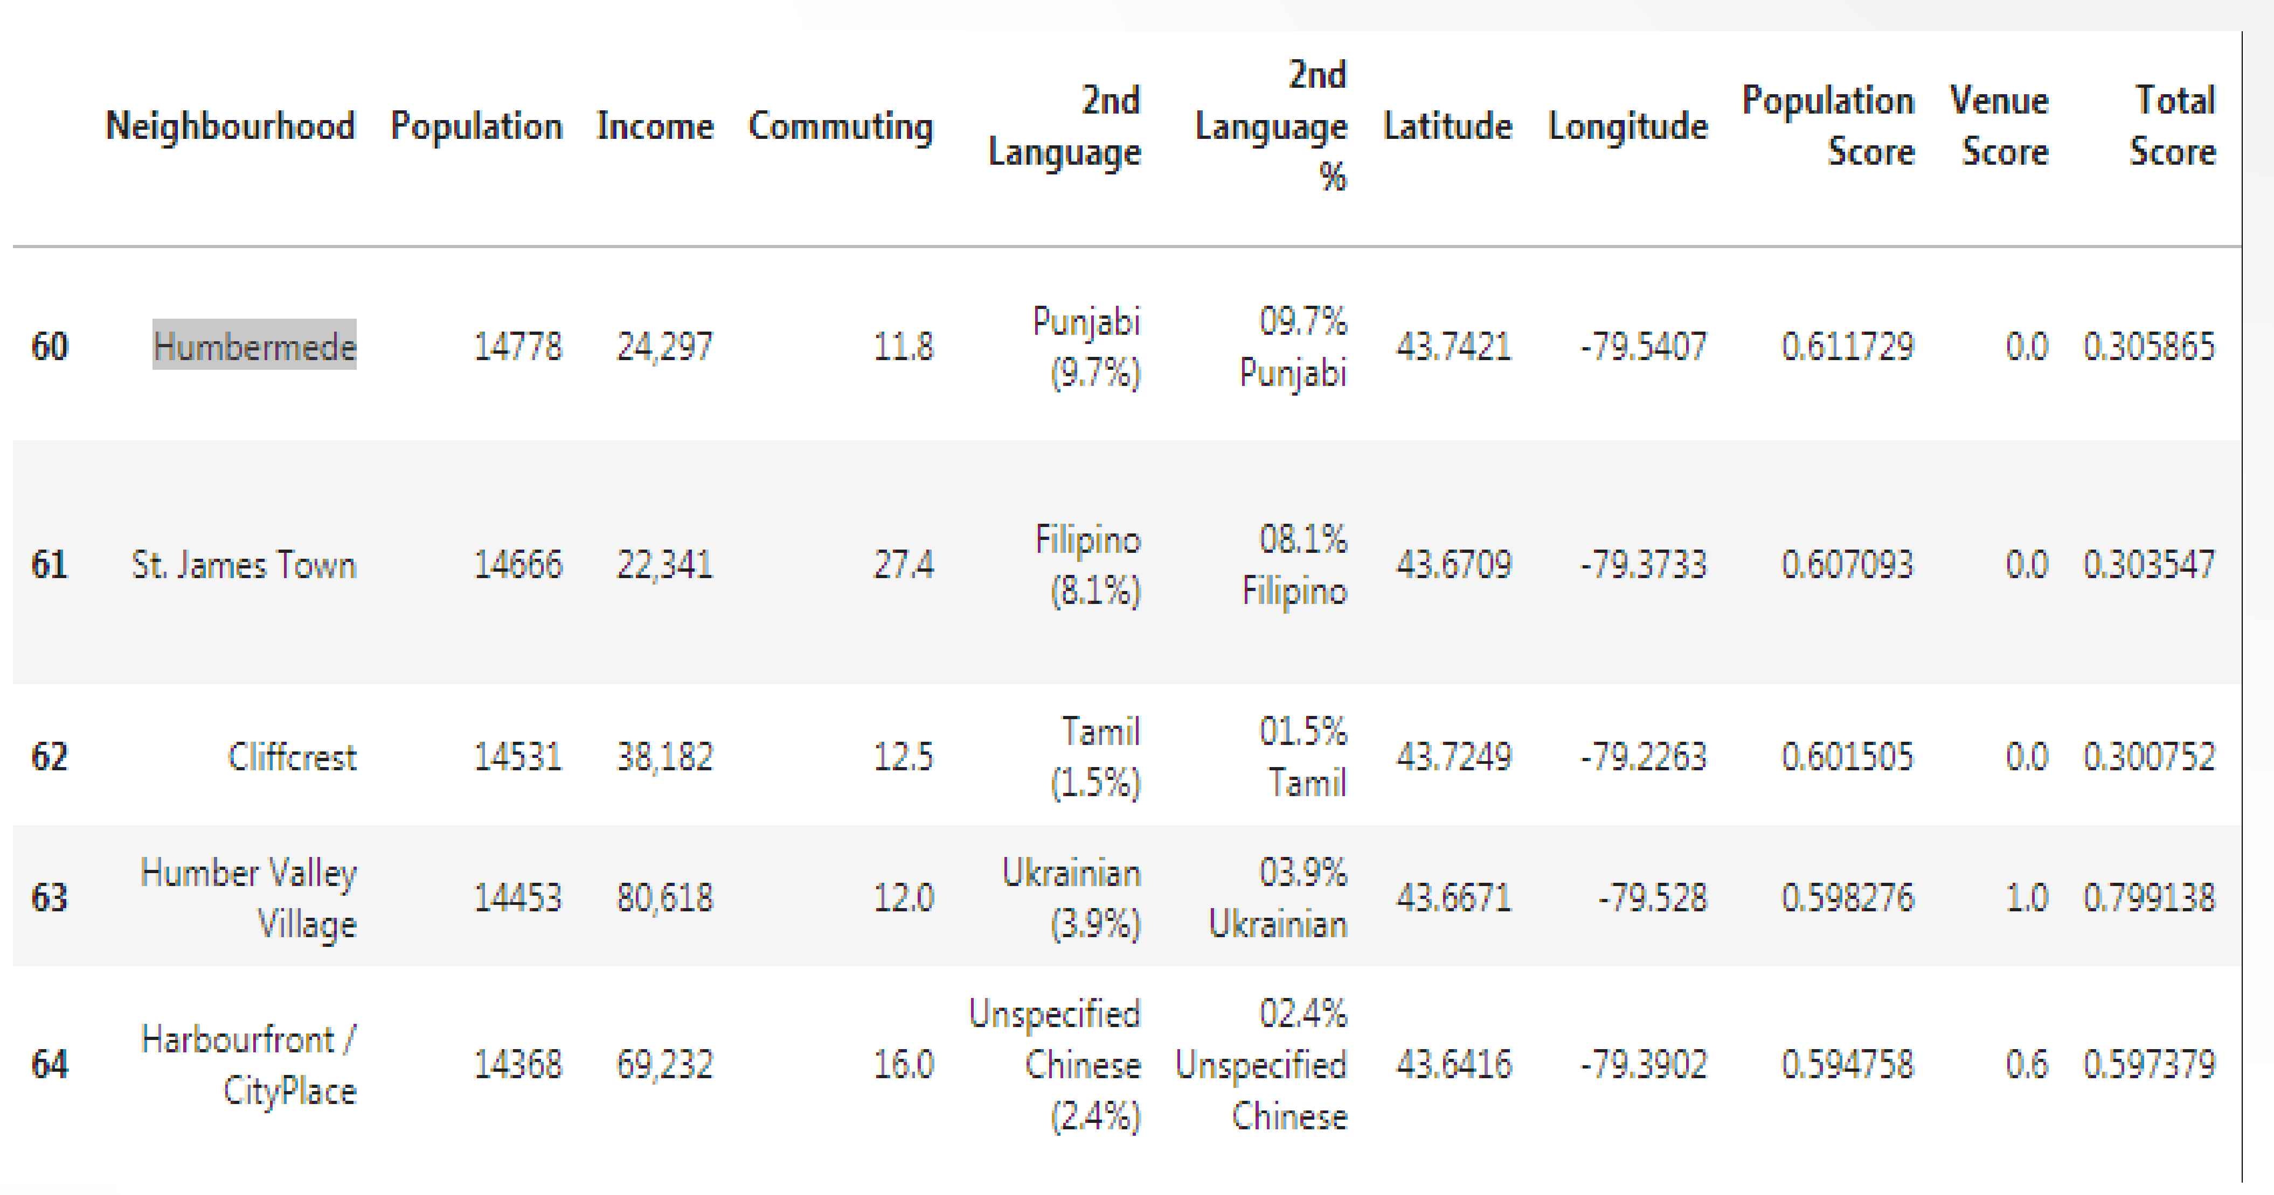
Notes:
© Copyright PresentationGo.com – The free PowerPoint library

Slide 13
CONCLUSION
• Recommendation Summary:
•Region: First Cluster.
•Neighborhood: Humbermede
•Additional Offering: Punjabi food or related supplies.
• Additional Note:
• Re-run of the program is encouraged to get latest information.
• Updated information is critical to consider as part of business expansion plan.
Notes:
© Copyright PresentationGo.com – The free PowerPoint library

